Slide 1

Freshco
HOME DELIVERY-2021

Slide 2
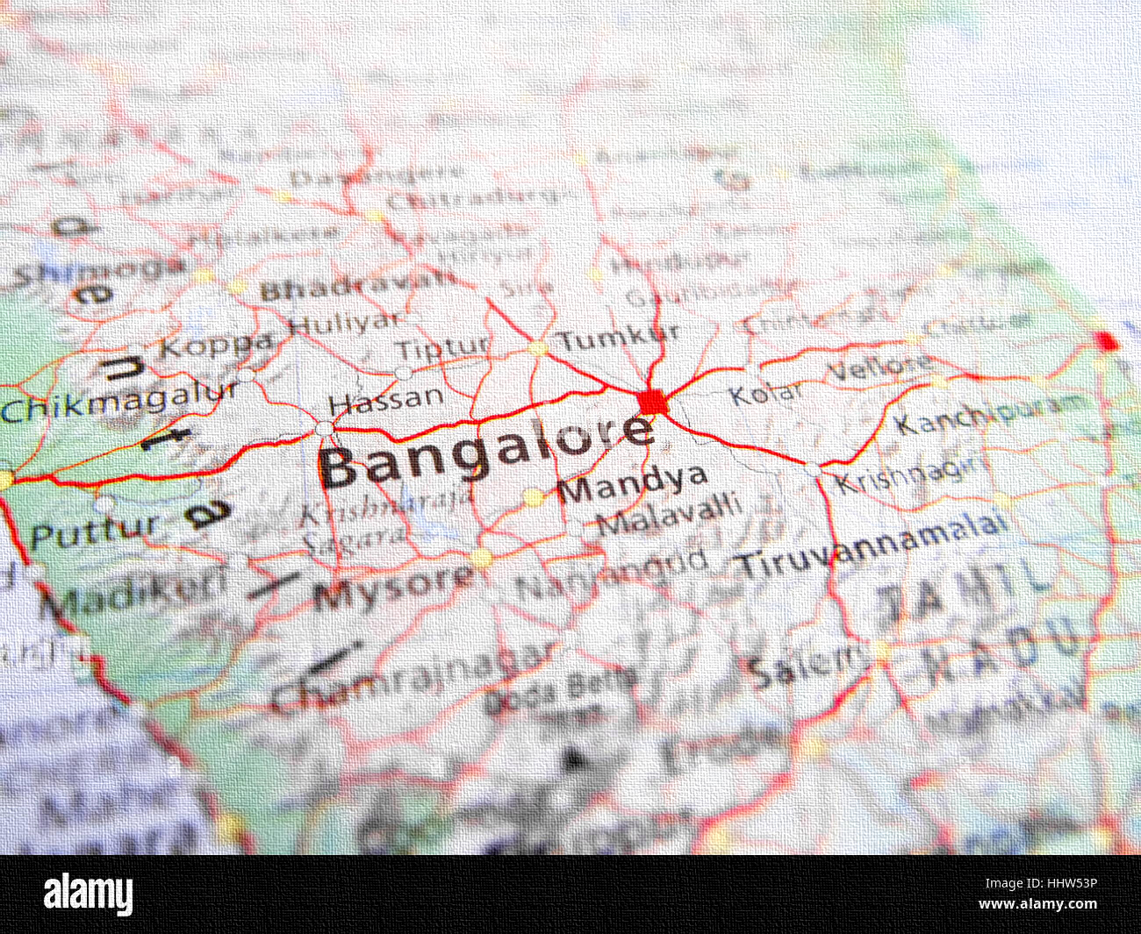
MY ANALYSIS
ORDER LEVEL
COMPLETION RATE LEVEL
CUSTOMER LEVEL
DELIVERY LEVEL

Slide 3
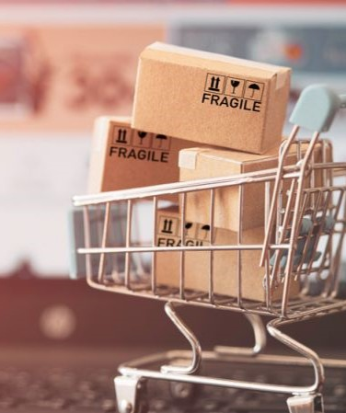
Order level analysis

Slide 5
MY OBSERVATIONS ON LOW ORDER DISTRIBUTION
Distant delivery locations
Lack of awareness regarding home delivery availability
Limited infrastructure to provide delivery
Areas around market competitors’ locations
Economic factors

Slide 6
MY INSIGHTS
DEMAND
Identify slot-wise peak hours and allocate resources like delivery staffs, delivery vehicles, etc efficiently.
Evaluate area-wise order distribution and work on marketing strategies to increase sales in the areas with lower distribution.
CUSTOMER CLASSIFICATION
Classify customers based on their response to delivery charges and discounts
PROFITABILITY
Evaluate profits at different delivery areas and time slots by comparing the distribution, revenue, etc.
PLANNING
OPERATION EFFICIENCY
Rule out operational inefficiencies like delayed delivery person allocation, delayed order pick-up, missing products in the delivery, etc. and implement measures to streamline operations and improve customer satisfaction.
Use data history to forecast future demand and plan inventory levels, delivery vehicle availabilities, staffing, etc.

Slide 7
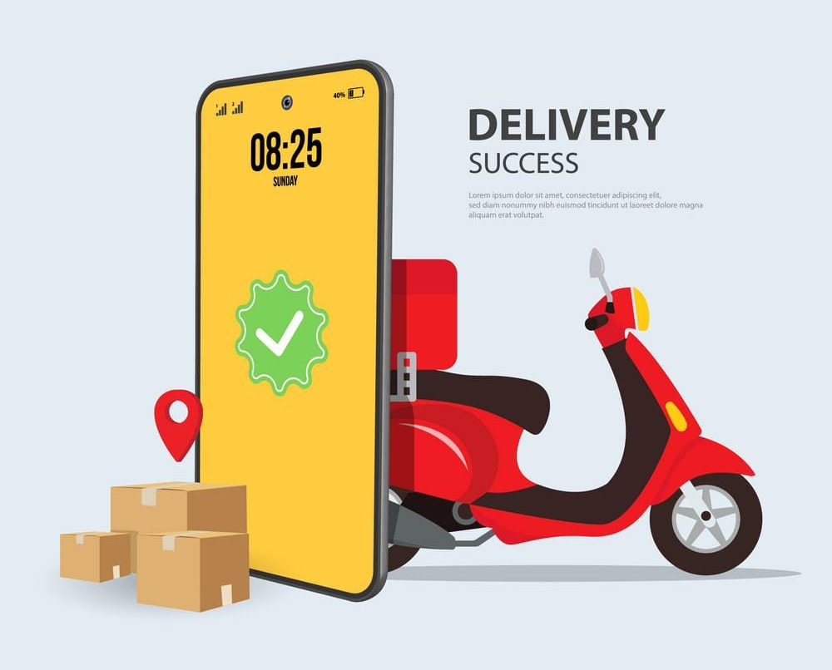
COMPLETION RATE LEVEL Analysis

Slide 8
COMPLETION RATE AT SLOT VS DAY OF WEEK

Slide 10
COMPLETION RATE AT DROP AREA LEVEL

Slide 13
MY INSIGHTS AND OBSERVATIONS
PEAK HOURS
CR will be low, when demand is higher and delivery resource is low.
TRAFFIC
Traffic during certain time of the day or week will cause delay.
RESOURCE
Limited delivery personnel, vehicles, and warehouse resources in certain time of the day or week may restrict the capacity to fulfil orders. We can hire freelancers to deliver during peak hours when the demand is higher.
DELIVERY PARTNER UNAVAILABILITY
During weekends, regional or local festive occasions, there might be a shortage of delivery staffs, causing many delivery failures or order cancellation from the merchant side. We can introduce overtime incentives or compensatory leaves to encourage delivery staffs to work on those days.
CUSTOMER UNAVAILABILITY
Order cancellations due to customer unavailability to receive the order.
MARKET DYNAMICS
Seasonal trends and social media influences may impact on customers and home delivery orders.
COMPETITION
Market competitors providing timely discounts, either for home delivery or store encourage the customers to prefer them over us.

Slide 14

CUSTOMER LEVEL ANALYSIS

Slide 15

ACQUISITION source

Slide 17
LTV | Count of users
0-4999 | 3300
5000-9999 | 283
10000-14999 | 77
15000-19999 | 45
20000-24999 | 19
25000-29999 | 7
30000-34999 | 5
35000-39999 | 5
40000-44999 | 6
45000-49999 | 1
50000-54999 | 1
60000-64999 | 1
Total | 3750

Slide 18


Slide 19
MY INSIGHTS AND OBSERVATIONS
ACQUISITION SOURCE
CUSTOMER LTV
We should use the customer LTV we derived from data to understand their long-term profitability and reward high-value customers to retain them.
While analysing the source-wise data to identify which source gained more customers, I noticed that we gained more customers via Google advertisements and organic sources and less via Instagram. We should continue investing in such resources to sustain gained customers and to acquire new ones.
CUSTOMER CLASSIFICATION
We can classify the customers based on their source and LTV to target customers with low LTV and those who are unaware of our facilities.
CHURN PREDICTION
We can work on analysing the data history to predict customer churn and rule out the factors associated with it and implement active measures to retain them and reduce churn in the future.

Slide 20
CUSTOMER SATISFACTION
We can assess the customer feedback and ratings on the delivery platform to identify areas of improvement in products, services, and overall customer experience.
LTV vs ACQUISITION COST
Comparing LTV with cost of acquiring them through different resources and assessing the return on such investments for each channel to prioritize those with highest profits.
REFERRALS
We should identify customers who refer new ones and analyse their impact on revenue and LTV. Implement new referral programs or incentives to encourage existing customers to refer others.

Slide 21

Delivery level Analysis

Slide 22
AVERAGE OVERALL DELIVERY DURATION-DROP AREA LEVEL

Slide 24
AVERAGE OVERALL DELIVERY DURATION AT TIME SLOT LEVEL

Slide 25
DELIVERY CHARGE AT DROP AREA LEVEL

Slide 28
MY INSIGHTS AND OBSERVATIONS
SEASONAL TRENDS
There isn’t much variations in overall average delivery time in the last 9 months. Moving forward, if we see any increase in demand, we can hire more part-time employees or freelancers.
GEOGRAPHIC DISTRIBUTION
DELIVERY COST
Valuate the delivery charge and discount as % of product amount on customer behaviour and overall sales and determine necessary action to improve revenue while maintaining customer satisfaction.
We can use geospatial analysis to optimize delivery routes for areas with delayed delivery. Monitor city locations thoroughly for any restriction in route for delivery.
We should monitor their behaviour as well with regards to customer satisfaction and delivery time and provide behavioural improvement programme if needed.
DELIVERY PARTNER
PREDICTION
With the history of data, we can work on predicting the future demand and implement adequate resources such as stocks, delivery partners, or delivery vehicles.

Slide 29

SUMMARY

Slide 30
PLANNING
To improve low order distribution in some areas.
MARKETING
Work on investing in better marketing sources to gain more customers
DESIGN
Improve the structure of delivery app to attract many customers
STRATEGY
Employ freelancers to facilitate optimal delivery during high demand
LAUNCH
Referral programs and incentives for existing customers
1
2
3
4
5

Slide 31
A satisfied customer is the best business strategy of all.
MICHAEL LEBOEUF

Slide 32

THANK YOU
SUSHMITHA RAMAKRISHNAN
sush.rk@outlook.com

